Slide 1
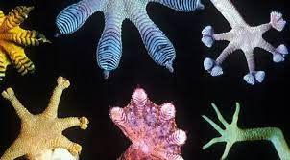
Artificial Gecko Skin
Lana Al-suwaidi
Allied Health
Deven Sterzing
Biomedical Engineering
Matthew Dean
Management Information Systems
Audrey Poore
Entomology
Vladimir Coon
Materials and Science and Engineering

Slide 2
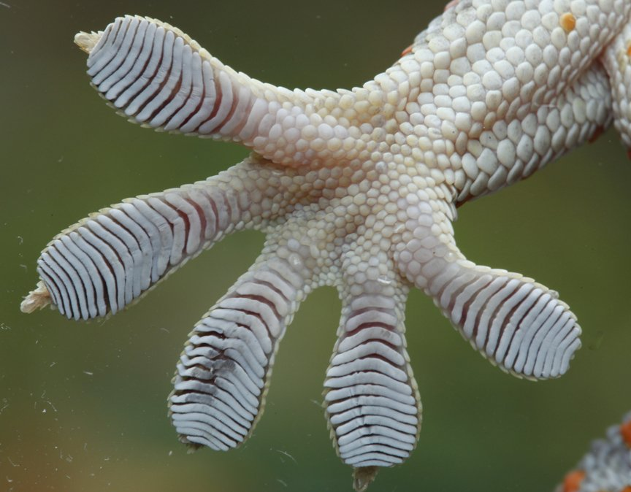
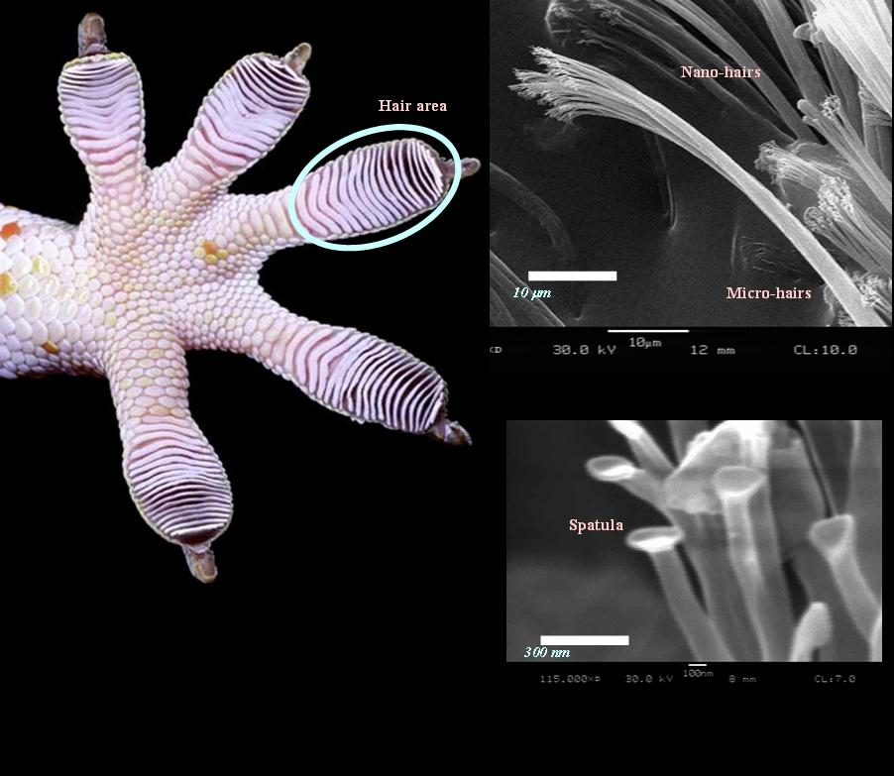
Gecko-skin has special characteristics that can be replicated and used in many industries.
The skin on a gecko’s hand and feet have spatula-shaped fibrils.
Skin on a gecko’s hands and feet also have tiny hairs, known as setae.

Slide 3
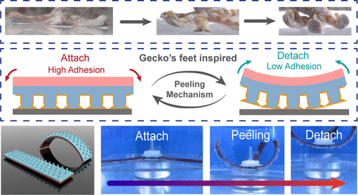

Slide 4
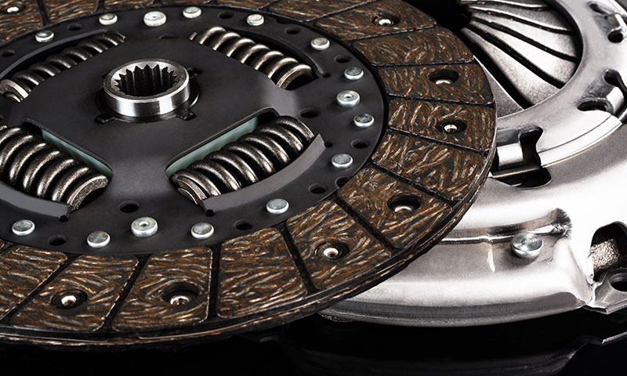
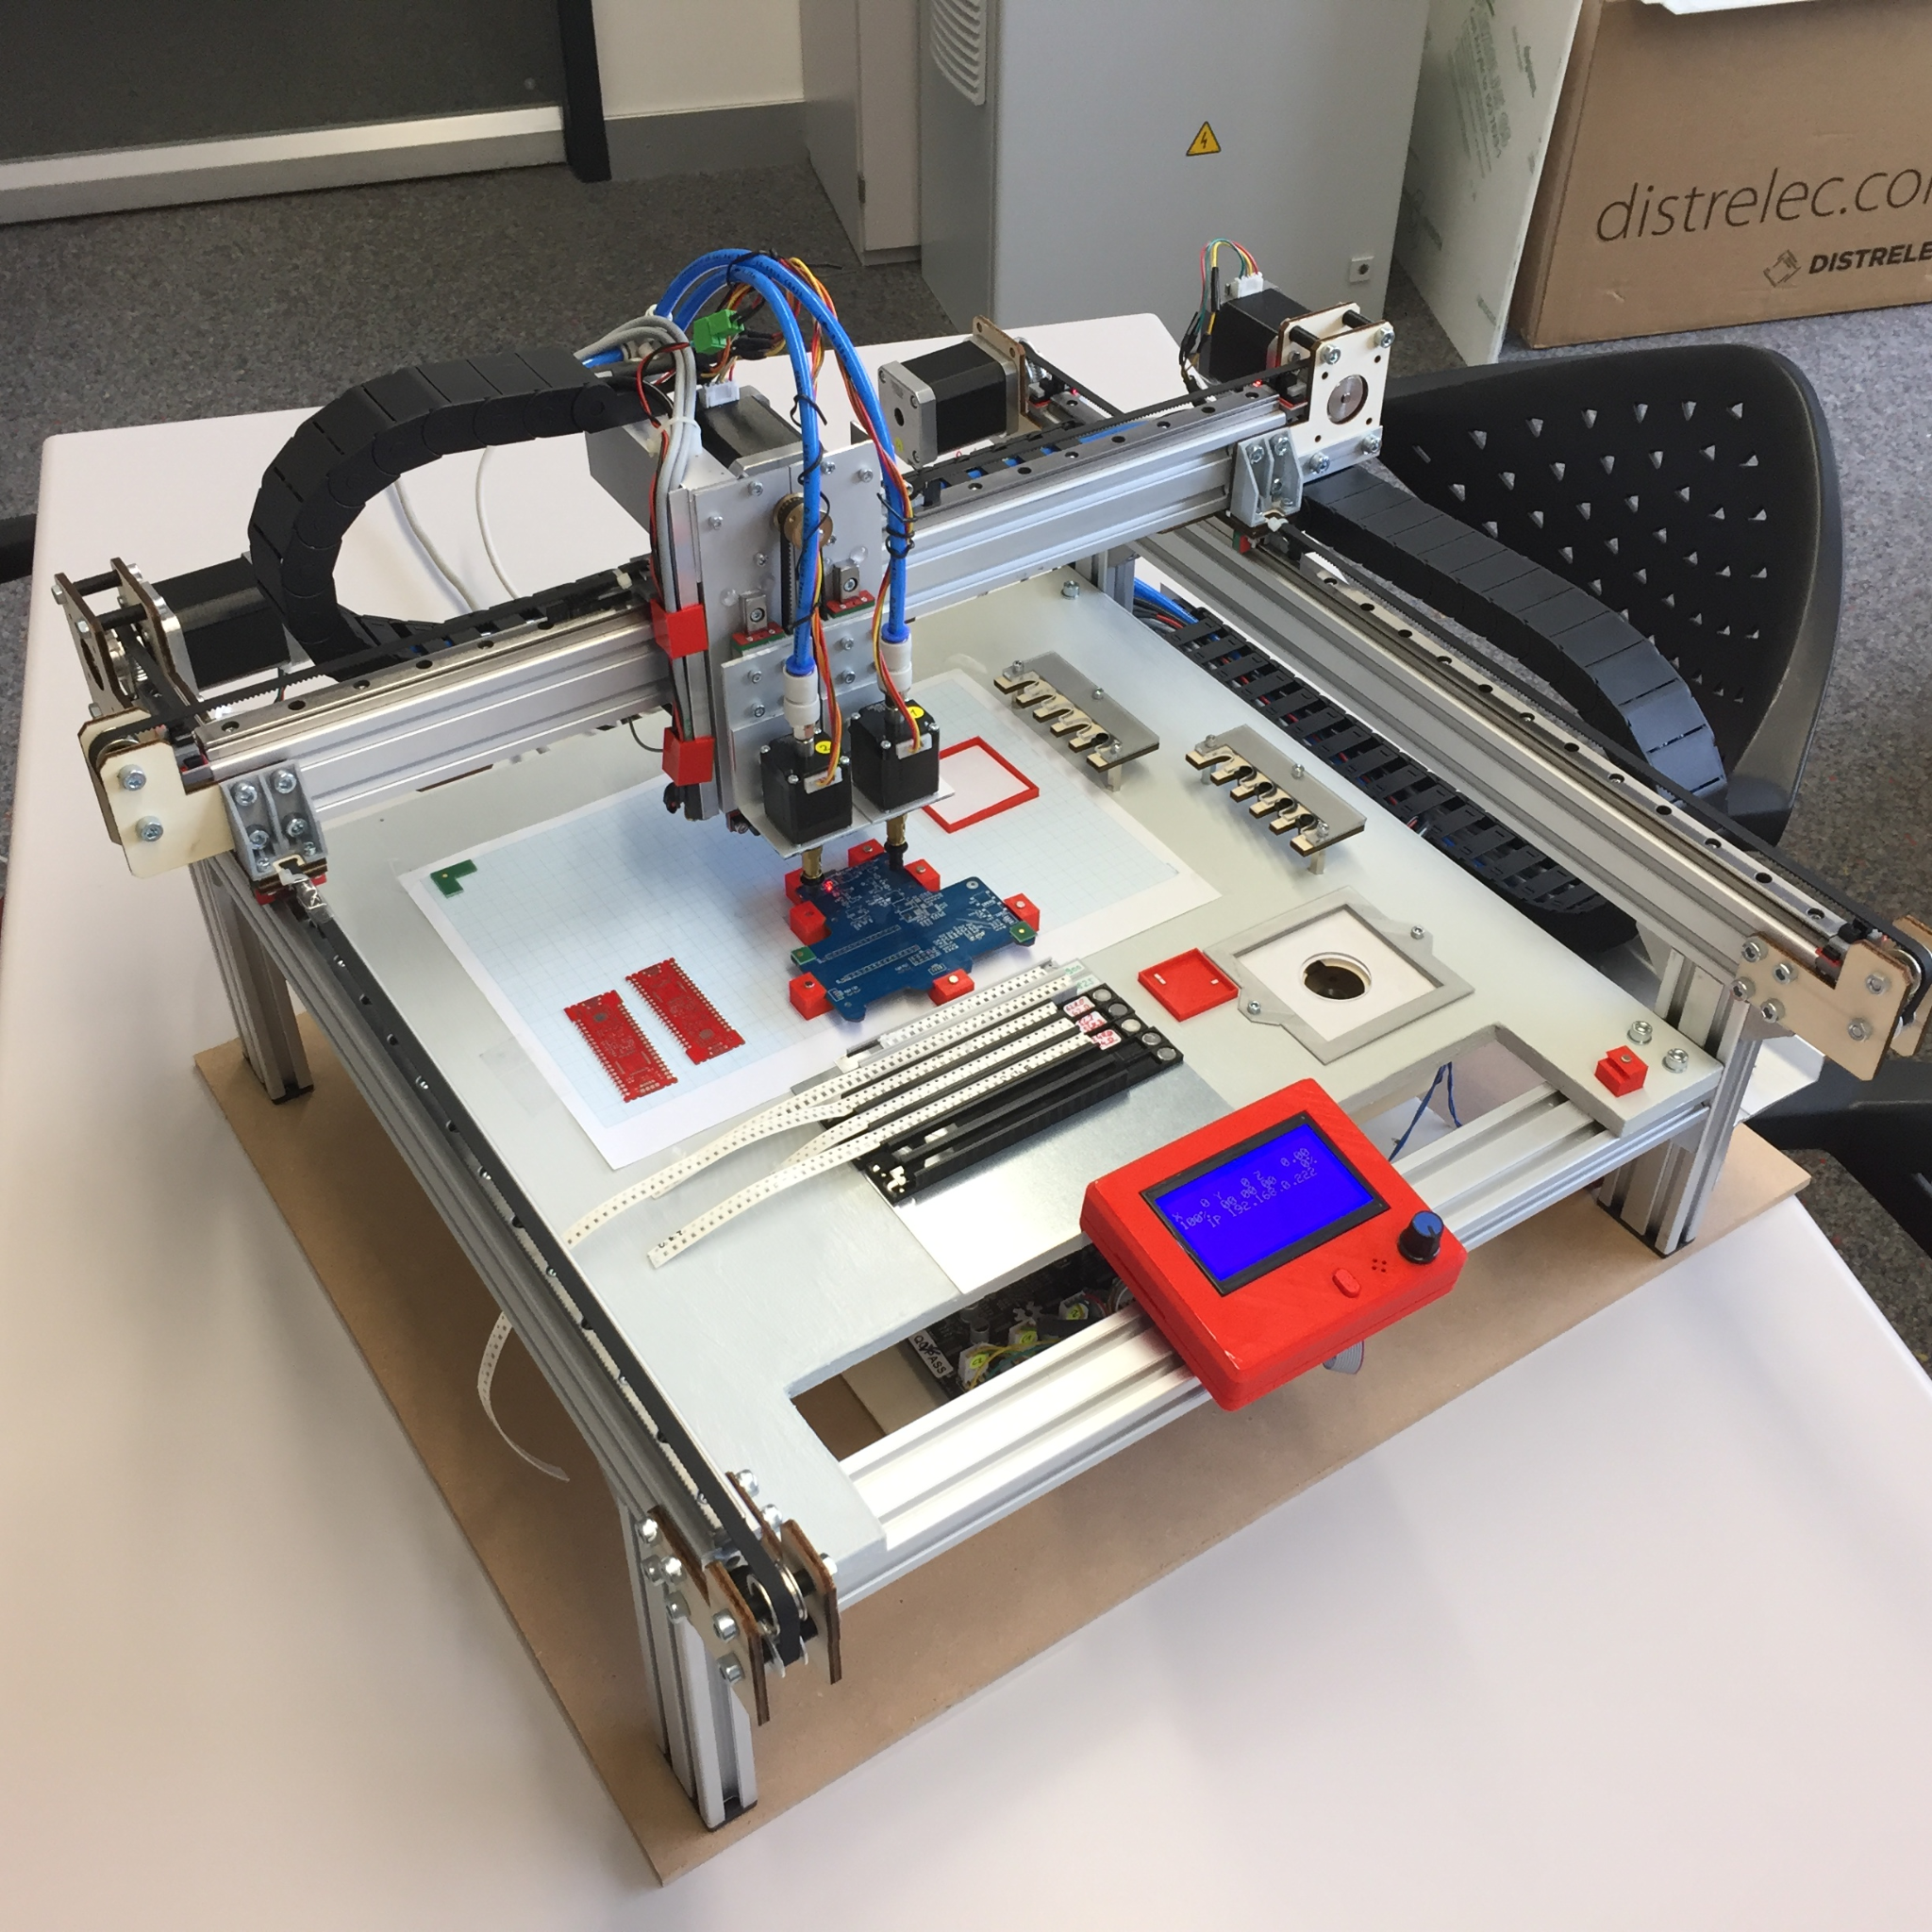
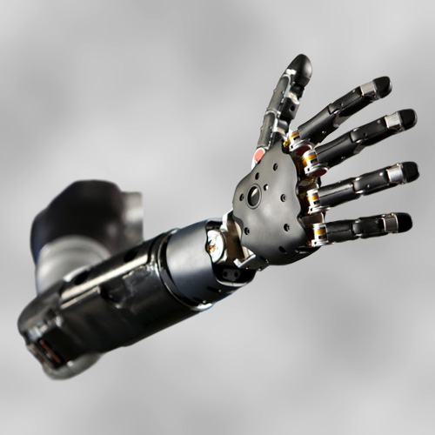
Many issues plague household, industrial, and biomedical industries that must be solved or improved.
Home and Automotive Applications
Industrial Applications
Biomedical Applications

Slide 5
Gecko skin has applications in home and automotive life

Slide 6
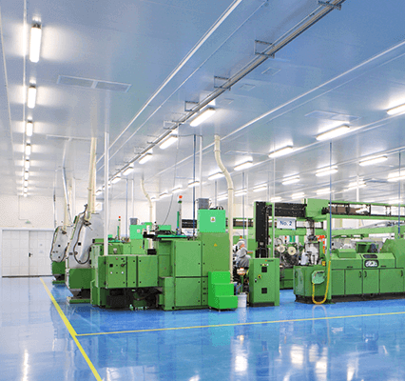
Gecko skin is needed in many industries

Slide 7
There are many needs in the biomedical field for gecko skin

Slide 8
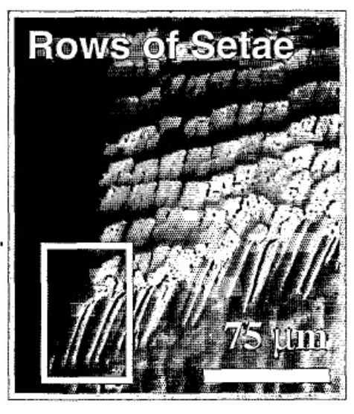
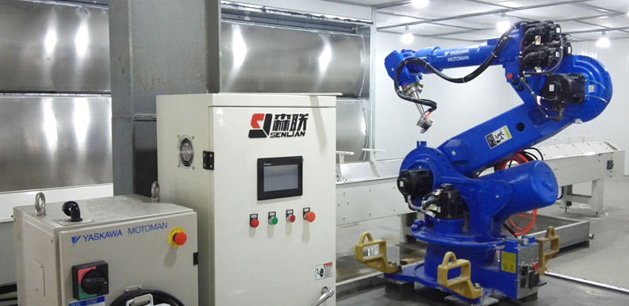
By building off of our predecessors technology, we have revolutionized gecko adhesive manufacturing.
How gecko inspired adhesion works
Our competitor’s manufacturing methods
Directly printing on a object

Slide 9
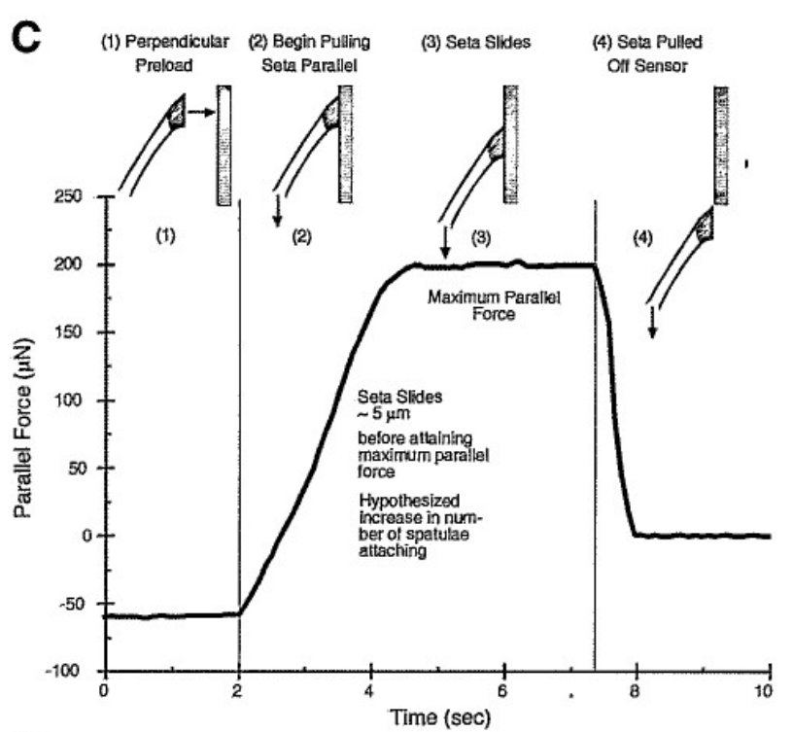
Gecko skin and adhesives inspired by it operate off of intermolecular forces.
Autumn and Peattie, 2002

Slide 10
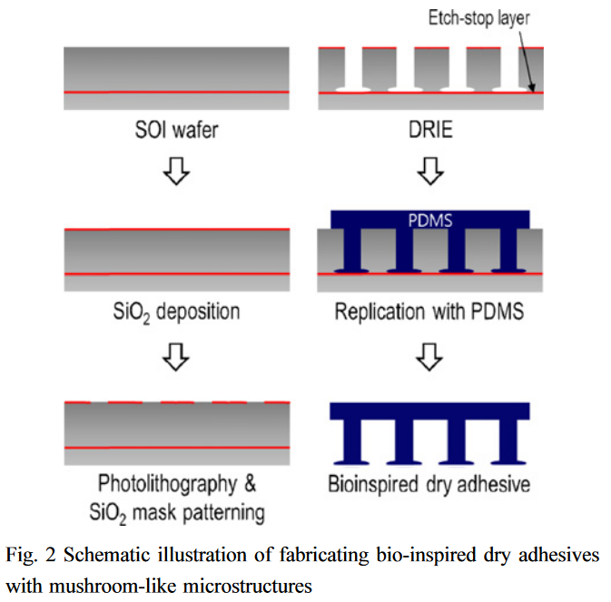
In the past decade, we have seen great advancements in economizing the synthesis of gecko skin.
Yi et al., 2014

Slide 11
Though a proprietary technology, we have developed a method of printing gecko skin directly onto substrates.

Slide 12
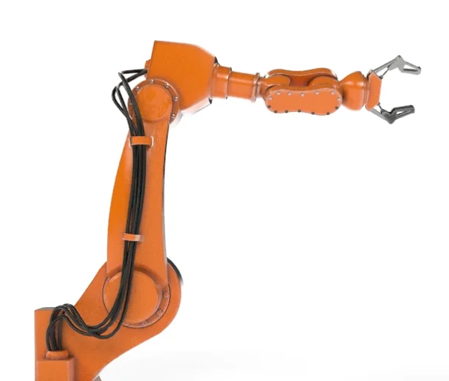
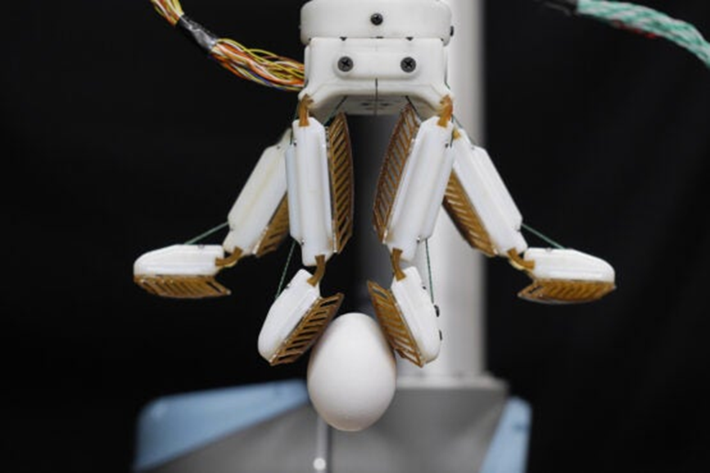
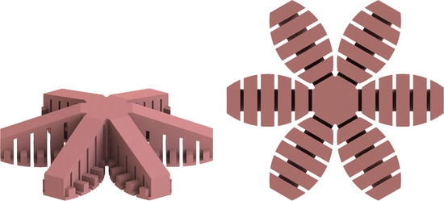
Manufacturing and assembly lines benefit from more delicate and dextrous machinery.

Slide 13
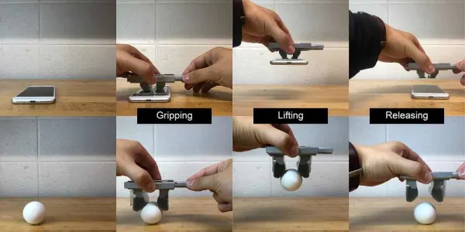

Slide 14
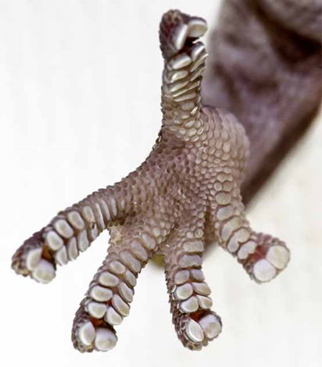
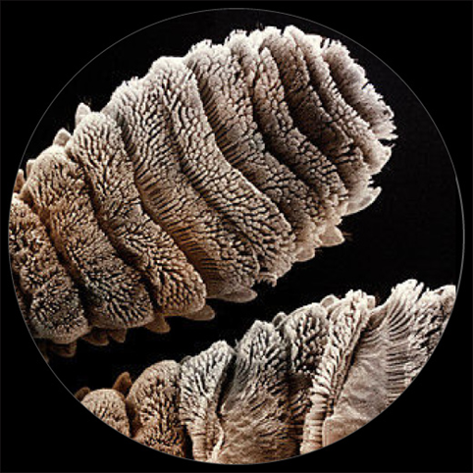
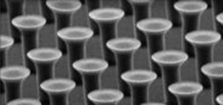
Gecko skin in the medical field could allow for more capable, comfortable medical equipment

Slide 15
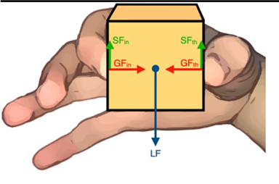
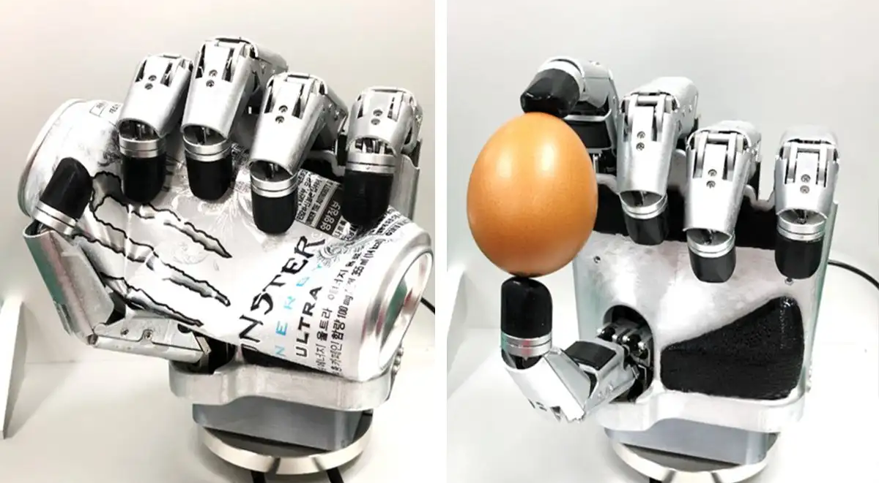
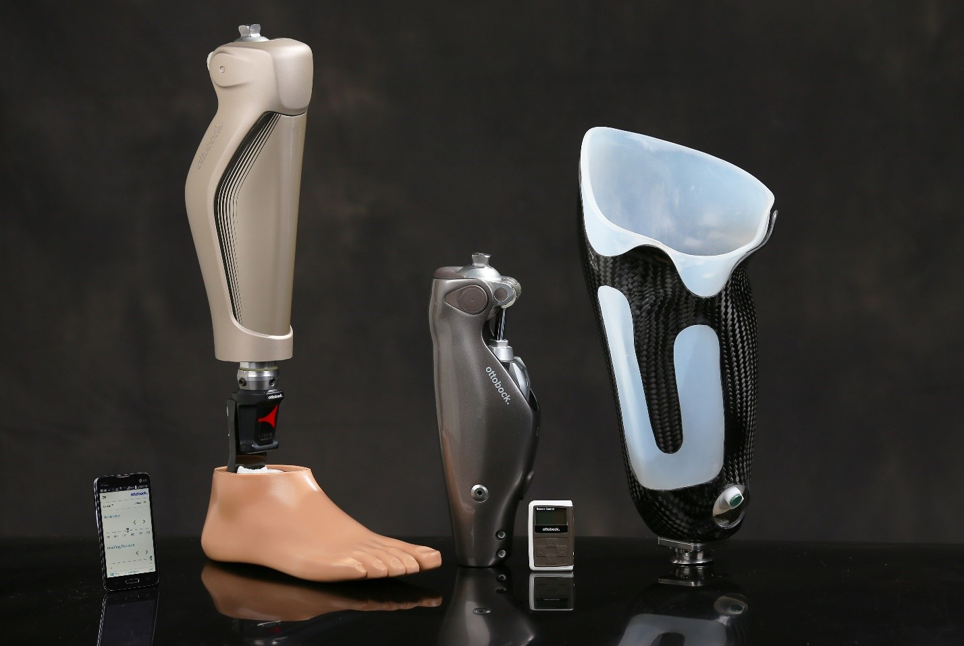
The replication of this structure can be applied to prosthetics for comfortable wear, or for more accurate handling.

Slide 16
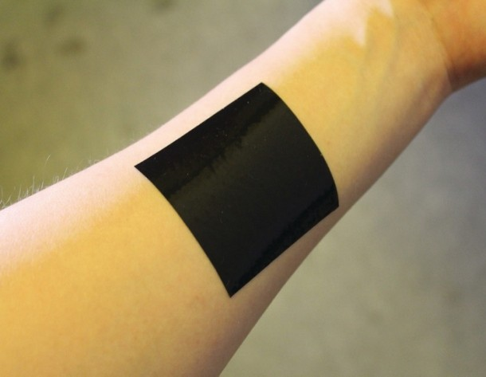
Gecko skin can also be used in replacement for bandages or sutures in the medical field as it grips to skin despite sweat/blood

Slide 17
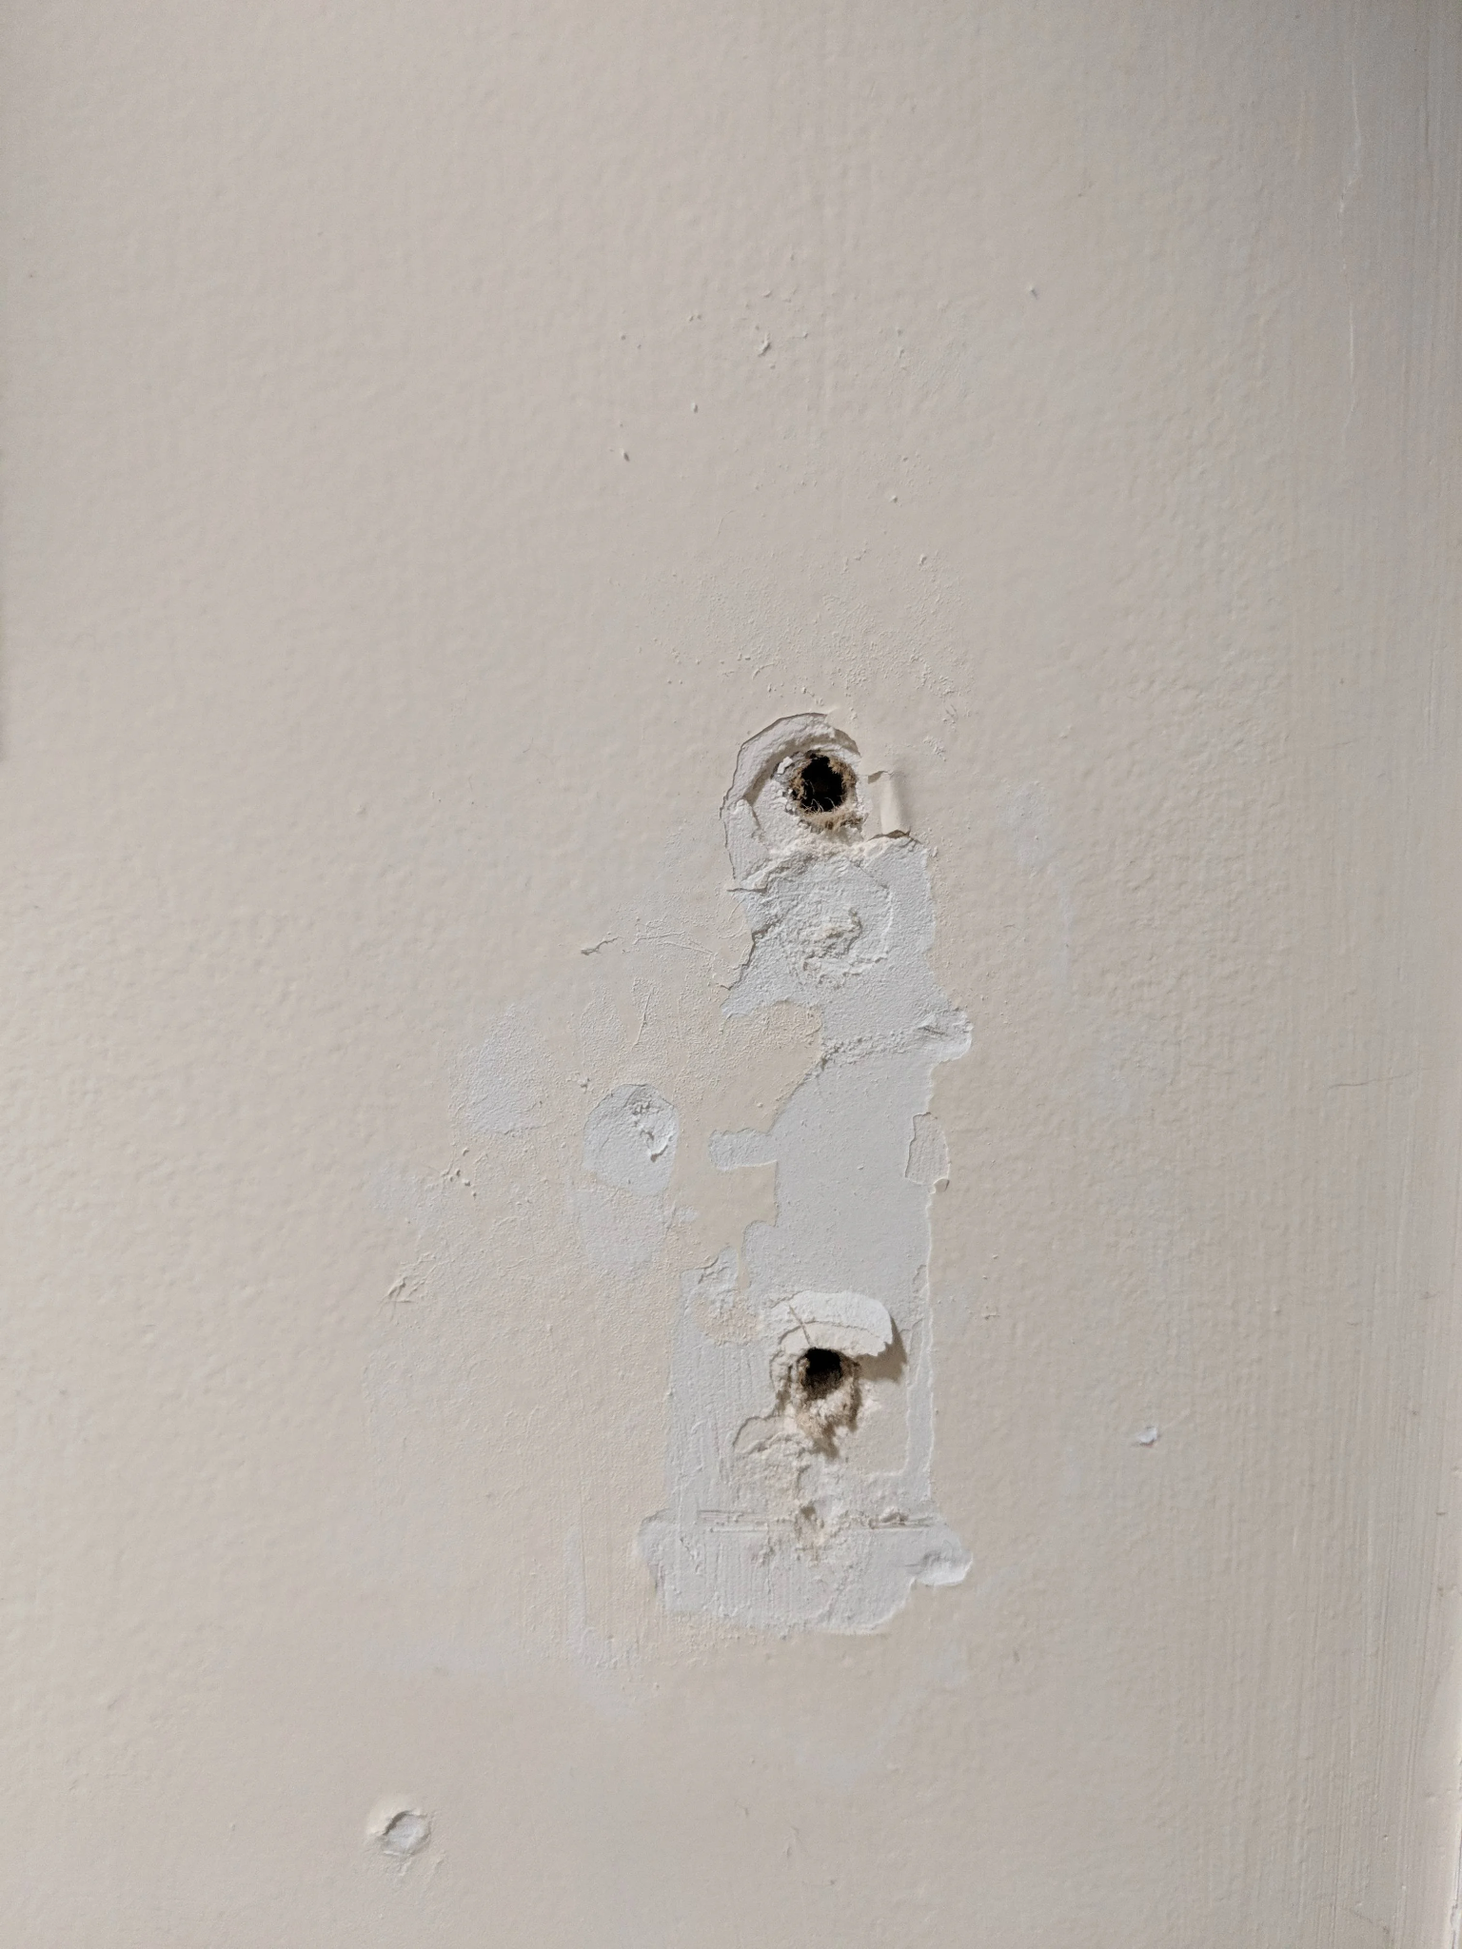
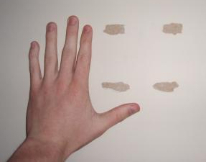
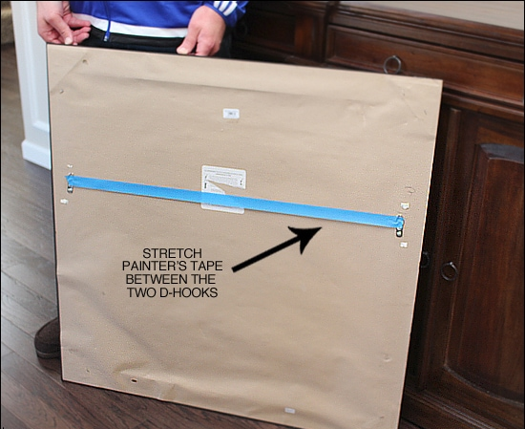
Imagine you’re hanging a picture or a heavy object. How would you do it?

Slide 18
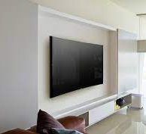
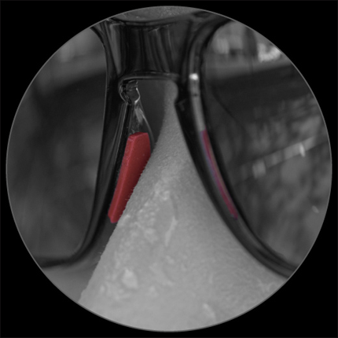
Everyday consumers benefit from the introduction of gecko skin into products through easily applicable adhesives from decorations to other articles.

Slide 19
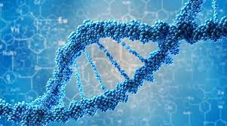
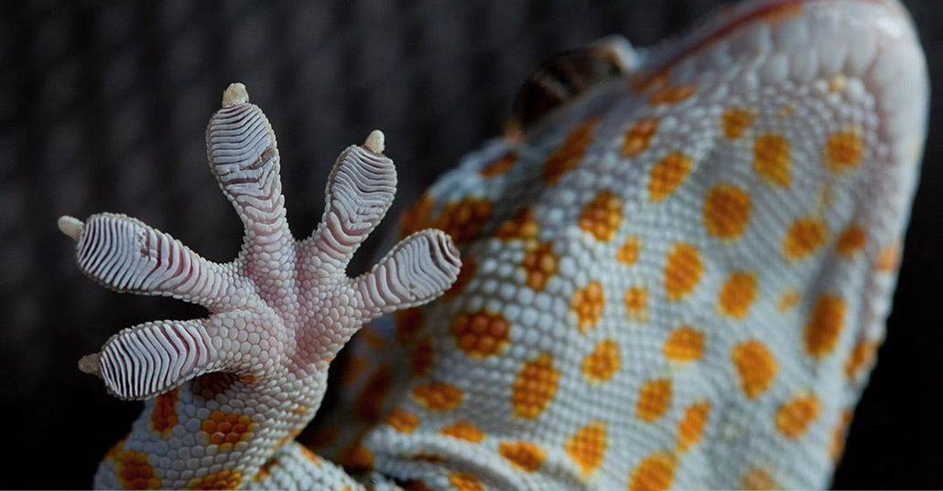
Our company presents a variety of business opportunities.
Biotech and manufacturing are rapidly growing industries.
Our team has perfected the manufacturing process.
We will use social media to promote our technology.

Slide 20
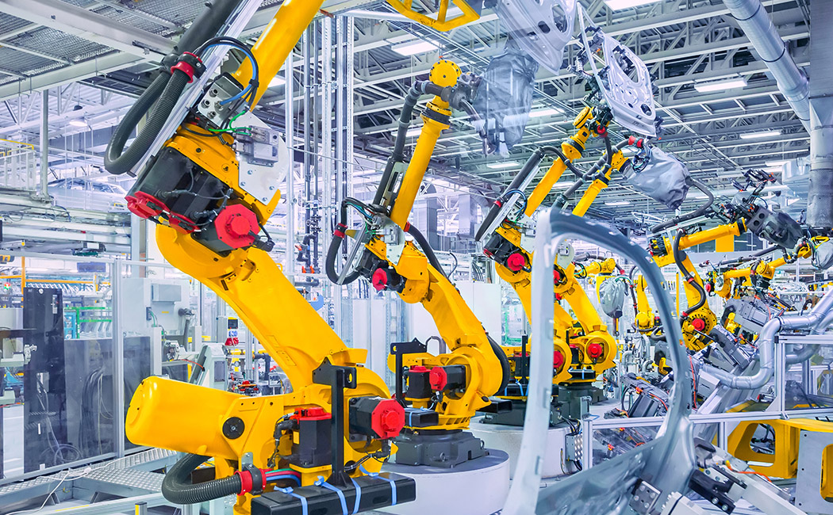
Variety of applications presents many opportunities.

Slide 21
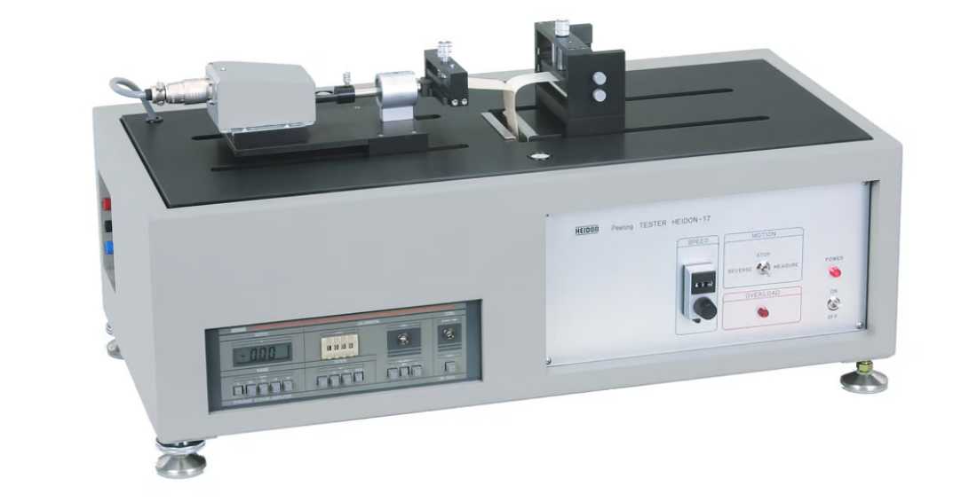
We have perfected the manufacturing process.

Slide 22
We will use the internet to promote our technology.

