Slide 1
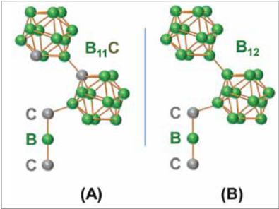
Boron Carbide:
The Armor of Tomorrow
Vladimir Coon
Materials Science and Engineering
Texas A&M University
Khan et al., 2017

Slide 2
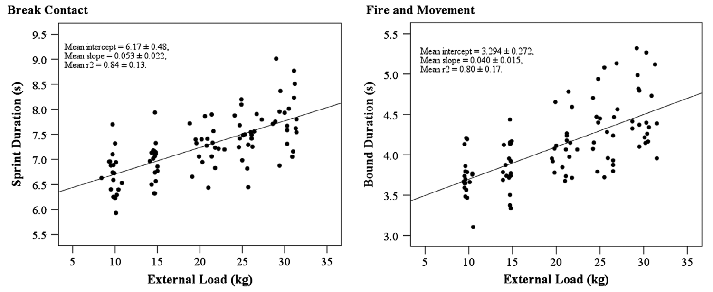
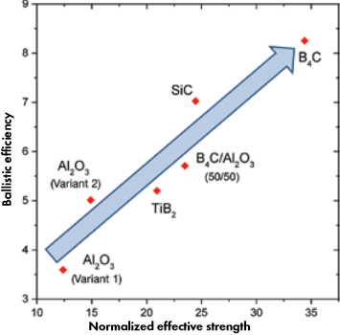
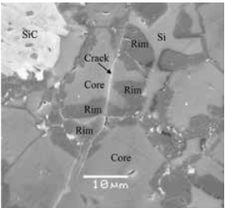
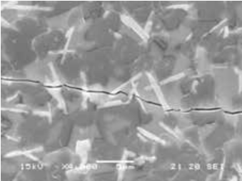
Boron carbide is a high performance ceramic which is well suited for use in body armor.
Developing lighter and less bulky armor is a necessary part of increasing US combat effectiveness.
Boron Carbide is a high performance ceramic that may be usable in the next generation of body armor.
Boron carbide’s weaknesses appear to be manageable.

Slide 3
Developing lighter and less bulky armor is a necessary part of increasing US combat effectiveness.
Hunt et al., 2016

Slide 4
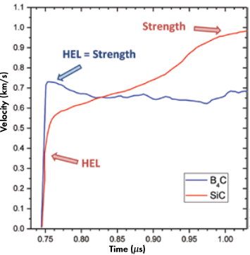
Boron Carbide is a high performance ceramic that may be usable in the next generation of body armor.
Khan et al., 2017

Slide 5
Boron carbide’s weaknesses appear to be manageable.
Hayun, 2017

Slide 6
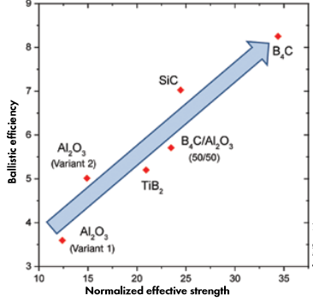
In conclusion, Boron carbide composites are very fitting for use in body armor.
Lightweight armor is a necessity on the battlefield.
Boron carbide composites can perform well across many velocities.
Questions?
Khan et al., 2017

